Slide 1
Object Oriented Programming Lecture - 24
Prof. Varsha Dange

Slide 2
Abstraction in Java
Abstraction is a process of hiding the implementation details and showing only functionality to the user.
it shows only essential things to the user and hides the internal details,
for example, sending SMS where you type the text and send the message.
You don't know the internal processing about the message delivery.

Slide 3
Contd..
Abstraction lets you focus on what the object does instead of how it does it.
Ways to achieve Abstraction
There are two ways to achieve abstraction in java
Abstract class
Interface

Slide 4
Abstract class
Abstract classes are declared with the abstract keyword
An abstract class can not be instantiated but can create reference
It can have abstract and non-abstract/concrete methods (method with the body).
It needs to be extended and its method implemented
It can have constructors and static methods also.
It can have final methods
an abstract class doesn’t need to have an abstract method compulsory.

Slide 5
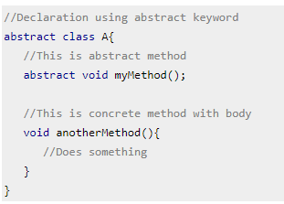
Abstract class declaration

Slide 6
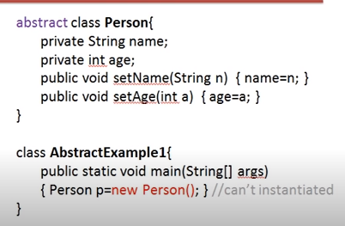
Contd..

Slide 7
Contd…
Abstract class cannot be instantiated which means you cannot create the object of it.
To use this class, you need to create another class that extends this class and provides the implementation of abstract methods,
then you can use the object of that child class to call non-abstract methods of parent class as well as implemented methods(those that were abstract in parent but implemented in child class).

Slide 8
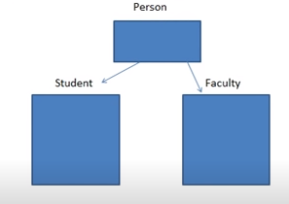
Why abstract class?
Abstract class is used to declared common characteristics of sub classes .

Slide 9
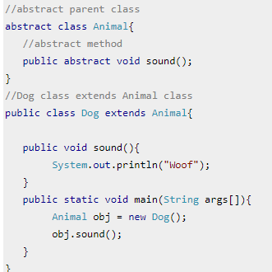

Contd…

Slide 10
Abstract method
A method which is declared as abstract and does not have implementation is known as an abstract method.
Abstract method has no body.
Always end the declaration with a semicolon(;)
Eg-abstract void printStatus(); //no method body and abstract
Its implementation should be provided by the sub classes.

Slide 11
Contd…
An abstract class must be extended and in a same way abstract method must be overridden.
A class has abstract methods then it must be a declared as abstract class
The class which is extending abstract class must override all the abstract methods.

Slide 12
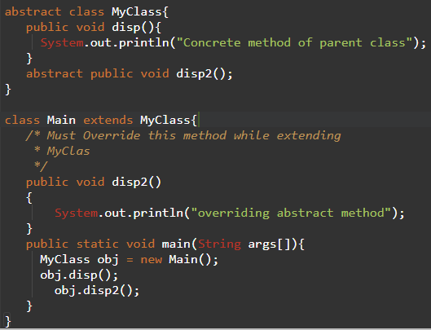

Contd…

Slide 13
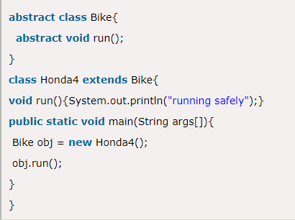

Contd…
Output:

Slide 14
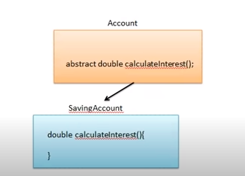
Why abstract method?

Slide 15
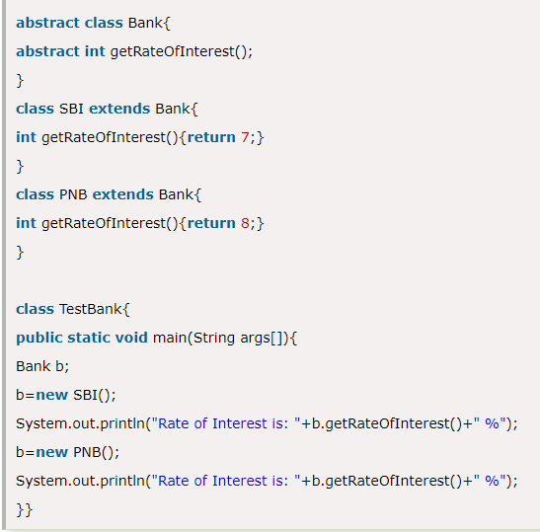

Contd..
Output:

Slide 16
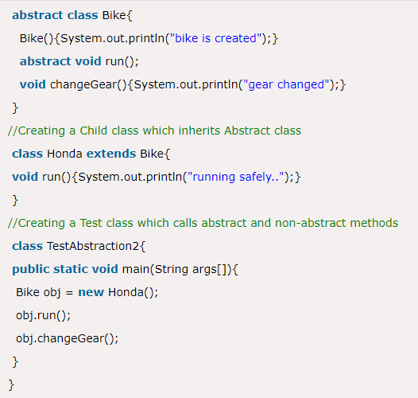

Abstract class having constructor, data member & methods

Slide 17
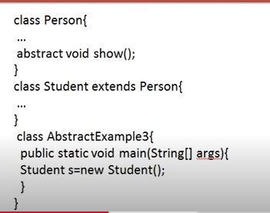
What's wrong with code?

Slide 18
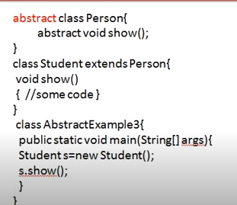
Correct code

